Slide 1
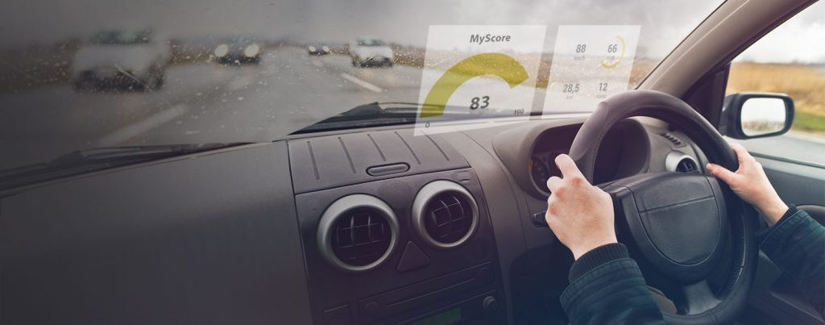
Driver Behavior Detection using CNN
A Machine Learning Approach to Enhance Road Safety
Presented By: Ashikul Kabir

Slide 2
Project Overview
Brief introduction to the problem of driver behavior detection
Importance of detecting unsafe behaviors to prevent accidents
Overview of the project's objectives and goals

Slide 3
Significance of the Topic
Driver behavior detection is important because:
It helps to identify potential cybersecurity threats by tracking user behavior and data access activities.
By analyzing both user behavior and data access activities, a behavior analytics tool can create a contextual behavior baseline to help discern behaviors that are abnormal and accurately identify critical safety threats.

Slide 4
Data Collection and Preparation
Dataset Description: The dataset consists of around 21500 images categorized into five classes: Safe driving, Talking on phone, Texting on phone, Turning, and Other activities.
Data Sources: Images collected from various sources to represent different driver behaviors. The dataset can be located at Kaggle website.
Preprocessing Steps: Included resizing, cleaning, and data augmentation to enhance model performance.

Slide 5
Data Preprocessing Techniques
Tools Used: OpenCV for image processing.
Steps Involved:
Resizing images to a uniform size
Normalizing pixel values
Augmenting data to increase diversity

Slide 6
Convolutional Neural Network (CNN) Architecture
Why CNN?
CNNs are effective for image classification tasks, capable of recognizing patterns and features in images.
Models Used: AlexNet, ResNet, and VGG16
Hyperparameters: Batch size = 64, Image height = 240, Image width = 240

Slide 7
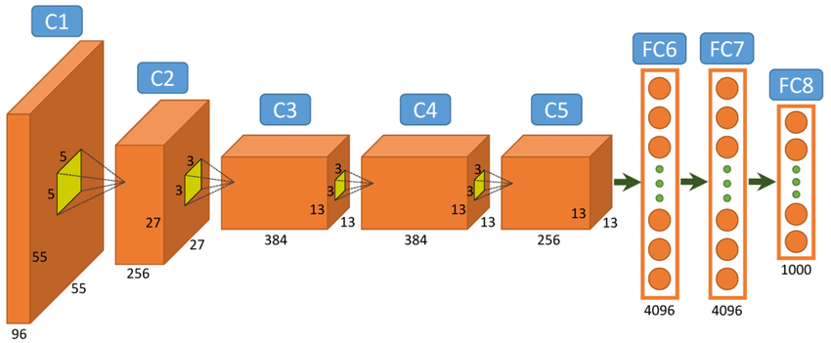
AlexNet
It is used primarily for image recognition and classification tasks
The network contains eight layers; the first five are convolutional layers, some of them followed by max-pooling layers, and the last three are fully connected layers
AlexNet uses ReLU activation functions and dropout regularization to prevent overfitting
AlexNet Model Architecture
Image Source: AlexNet Model Overview

Slide 8
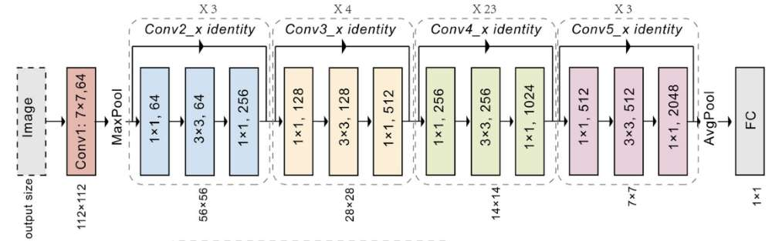
ResNet
ResNet (Residual Network) is a deep learning-based model that uses residual connections to improve training performance and accuracy
The architecture of ResNet is designed to solve the problem of vanishing gradients that occurs when training deep neural networks
ResNet introduces the concept of residual blocks, which use skip connections to connect activations of a layer to further layers by skipping some layers in between
This forms a residual block, and ResNets are made by stacking these residual blocks together
ResNet Model Architecture
Image Source: ResNet Model Overview

Slide 9
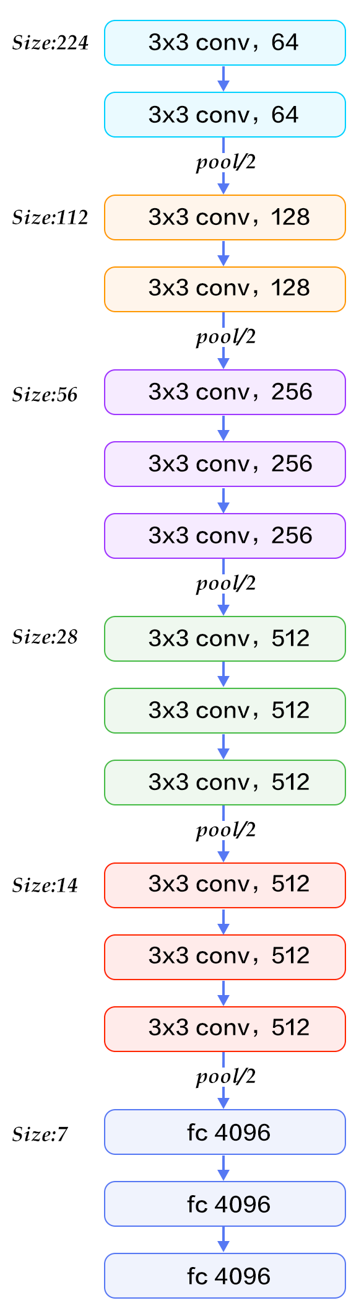
Pretrained Model - VGG16
VGG16 consists of 13 convolutional layers, 5 max-pooling layers, and 3 fully connected layers, making a total of 21 layers. Out of these, 16 are weight layers (convolutional and fully connected layers)
VGG16 emphasizes simplicity and uniformity by using small (3x3) convolutional filters consistently throughout the network
This design choice results in a deeper network with more layers, allowing the network to learn more complex features
Image Source: VGG16 Model Overview
VGG16 Model Architecture

Slide 10
Training and Validation
Training Process: Used TensorFlow and Keras libraries.
Data Split: Training (75%), validation(5%), and test sets(20%).
Metrics: Evaluated using accuracy and loss.

Slide 11
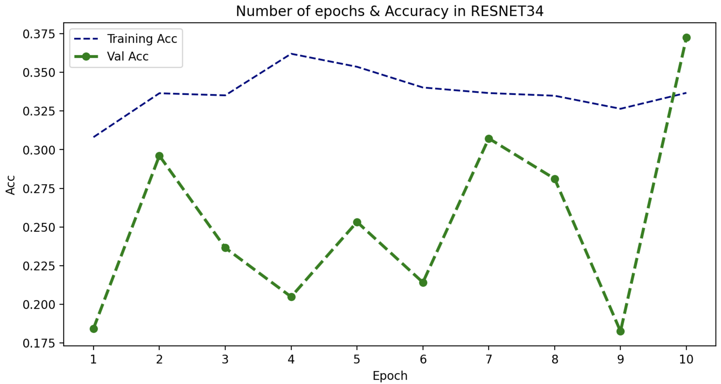
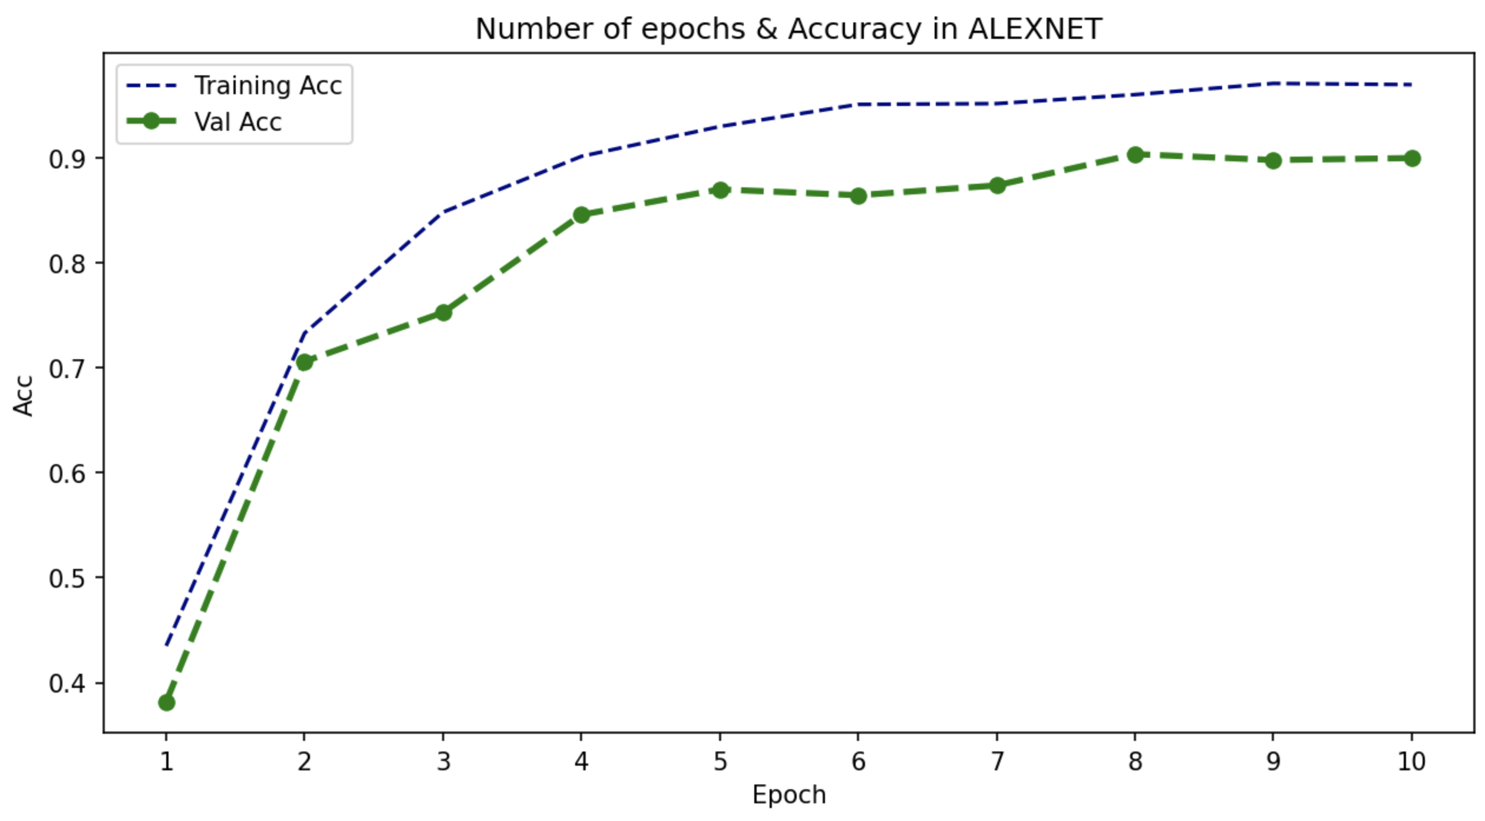
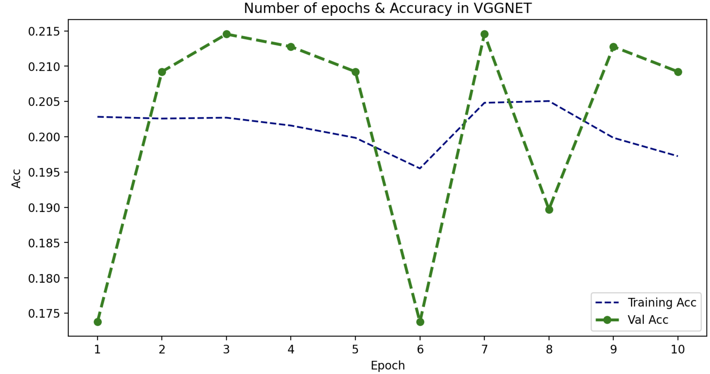
Model Performance
Accuracy and Loss Graphs: Plotted training and validation accuracy/loss over 10 epochs. Key Metrics: Model accuracy and loss values
Best Performer: AlexNet

Slide 12
Results
Model Accuracy Table
Based on the accuracy table above, the AlexNet model demonstrates strong performance with a slight indication of overfitting during training.
It achieves a significant accuracy score, qualifying it as a well-performing model suitable for deployment.
In contrast, the other two models exhibit low accuracy scores and, therefore, are not viable candidates for deployment.
 | AlexNet | ResNet | VGG16
Validation | 0.899 | 0.372 | 0.210
Training | 0.969 | 0.337 | 0.201

Slide 13
Model Deployment and Application
Integration with Camera System: OpenCV and other required libraries, such as TensorFlow and Keras, should be installed on the system. The camera should be connected to the computer and verified to be working properly. A Python script should be written to capture video from the camera using OpenCV and process it using the deep learning model. The script should then be run and tested with the camera.
Real-World Application: Potential use cases in enhancing road safety and reducing accidents by monitoring performance and optimizing fuel consumption.
Potential users: Fleet Management, Insurance, Transportation and logistics, and Ride-hailing companies like Uber and Lyft to enhance riding experience for potential customers.

